Slide 1
GDP and Industry Web Visualization Dashboard
Contributors: Denis Cohen
Donald Mullen
Cong Tran
Vijaybabu Gangaprasad

Slide 2
The Data
Source
Cleaning
Import
Retrieved dataset directly from the Bureau of Economic Analysis (official US Gov. website: https://apps.bea.gov/iTable/index_regional.cfm). The dataset was comprised of a .csv file. Image of clean data set shown in next slide.
Removed some of the unnecessary columns in the dataset that were irrelevant to our analysis/visualizations.
Imported .csv into SQLite database and used sql commands to extract the data needed for the visualizations.

Slide 3
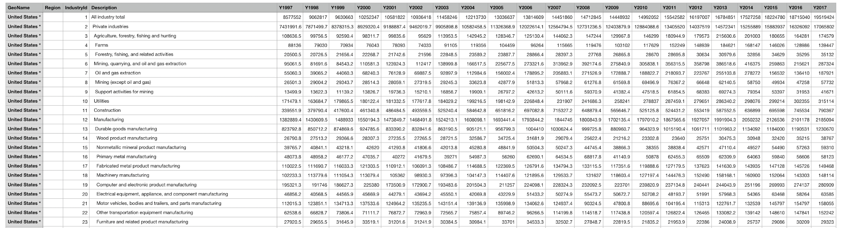
Dataset
Each State and US totals of GSP in millions of dollars broken down by each industry over time. Each industry has a corresponding ID show in the “IndustryId” column

Slide 4
Process
Build API
Create JS Script
HTML/CSS
Flask App
Used SQLAlchemy to build database connection with Flask App and used Python/SQL to build the JSONs for API and data extraction.
JavaScript
Created functions within JS file to pull data from the Flask App JSONs and create charts based on selected items from homepage
Dashboard
Used JS script file referenced in HTML to build dynamic charts (bar, doughnut, line) of the specific options chosen by user to present the data.

Slide 5
Chart.js
For this dashboard we decided to use Chart.js to incorporate into our JavaScript file to build a few of the graphs. The doughnut chart and line chart were both created with the Chart.js library. All of the the charts are dynamic and update depending on the user’s selection from the dropdowns on the webpage.

Slide 6
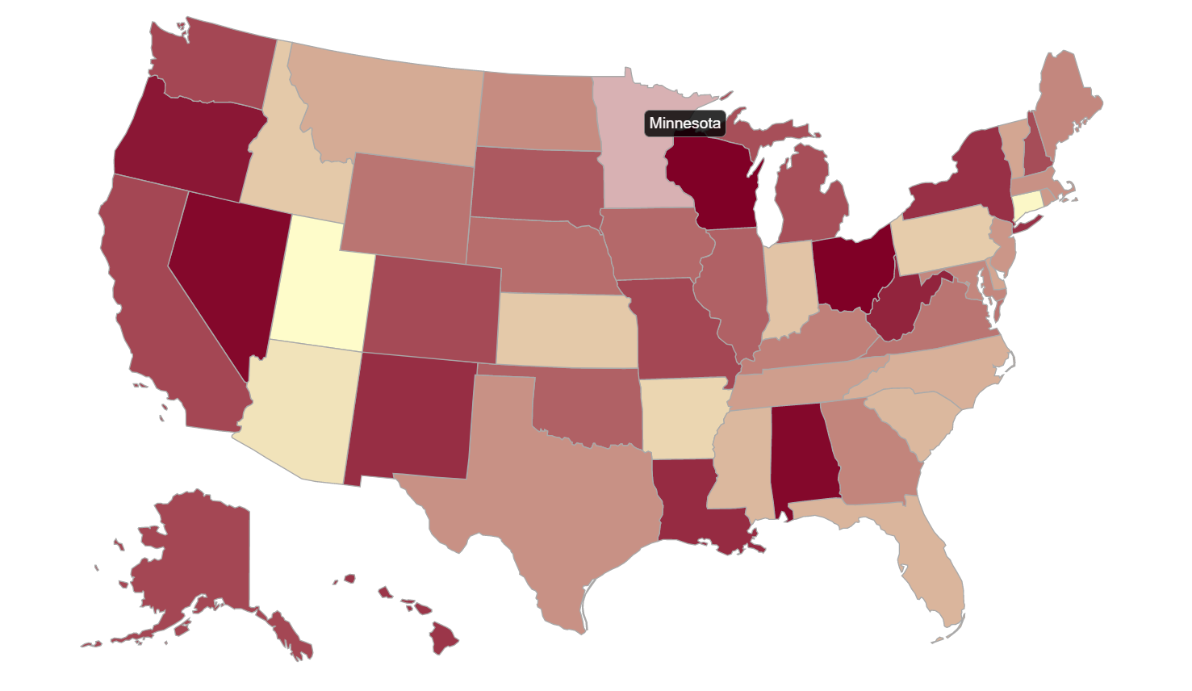
Visuals Used: Geomap

Slide 7
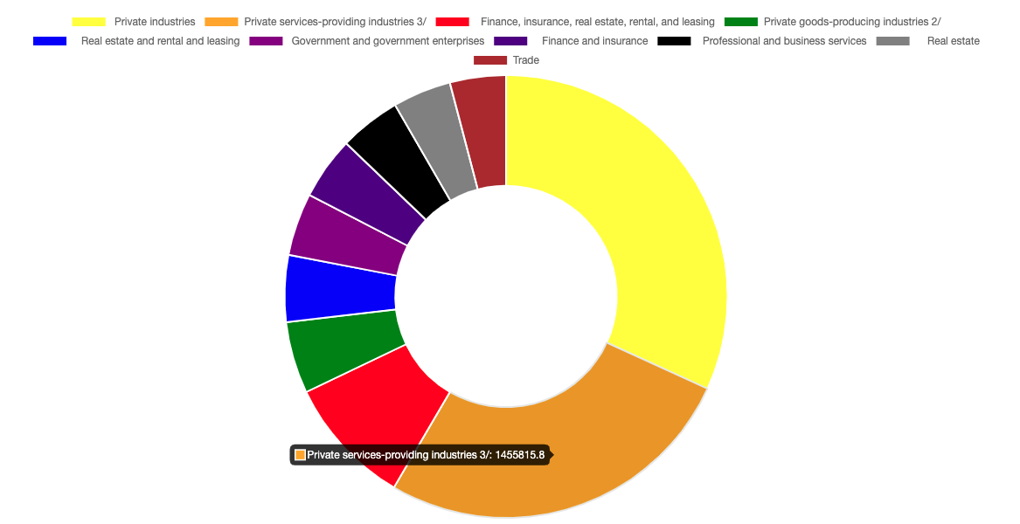
Visuals Used: Doughnut

Slide 8
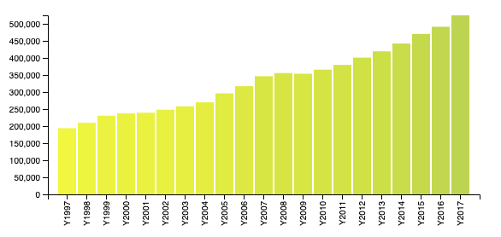
Visuals Used: Bar

Slide 9
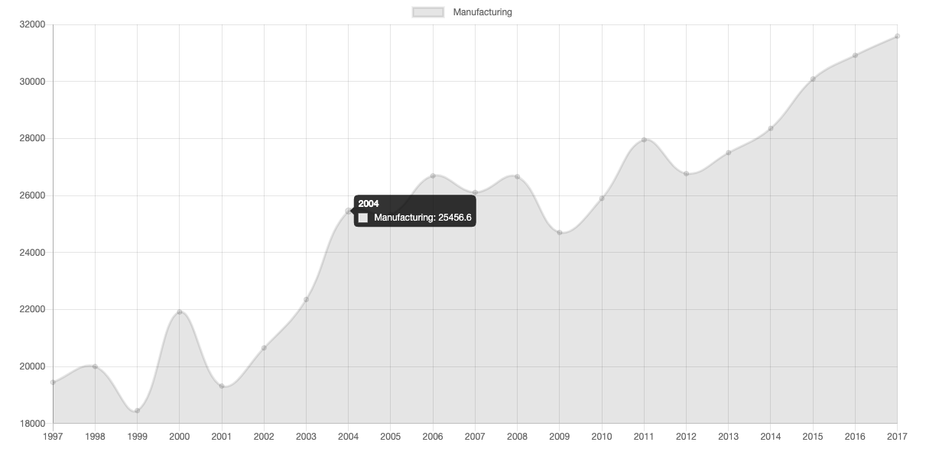
Visuals Used: Line

Slide 10
Dashboard Demonstration:

Slide 11
Questions?

